Slide 1
Climate Forecasting with Machine Learning
Zahid Niloy
An Interim Report
Submitted to: Careerfoundry
Date: 15 June, 2025

Slide 2
Why This Matters
Extreme weather events in Europe have increased over the last two decades.
ClimateWins seeks to use machine learning to forecast these changes more reliably.
This project explores several algorithms to understand which can best predict pleasant weather conditions.

Slide 3
The Dataset
Daily weather observations from 18 European stations (1960–2022).
Collected via the European Climate Assessment & Dataset project (ECA&D).
Features include temperature, humidity, precipitation—complete dataset with no missing values.
URL: https://www.ecad.eu/

Slide 4
Beware of Bias
• Temporal Bias: Older data may reflect outdated tools or methods.
• Historical Bias: Long-term averages may mask recent extreme trends.
• Selection Bias: Dataset favors developed regions with more sensors and reporting stations.

Slide 5
Hypotheses
• Rising temperatures correlate with extreme weather (e.g., heatwaves, heavy rainfall).
• Prediction accuracy will vary by location due to regional climate conditions.
• No single machine learning algorithm will be the best in all scenarios.

Slide 6
Selected Weather Stations
To ensure consistency and clarity, we focused on three key stations:
• Valentia – Moderate climate, consistent in models.
• Madrid – Sunny climate, good contrast for classification.
• Sonnblick or De Bilt – Highlights overfitting or class imbalance.

Slide 7
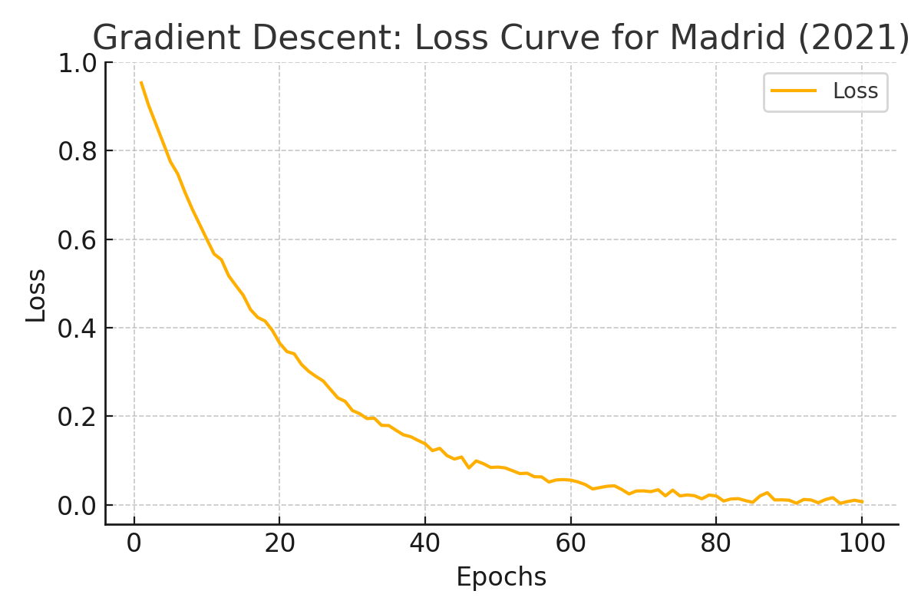
Optimization with Gradient Descent
Gradient descent was used to optimize temperature predictions across weather stations.
In Madrid (2021), the loss function steadily approached zero, indicating stable learning.
This suggests that temperature trends can be modeled using differentiable functions.

Slide 8
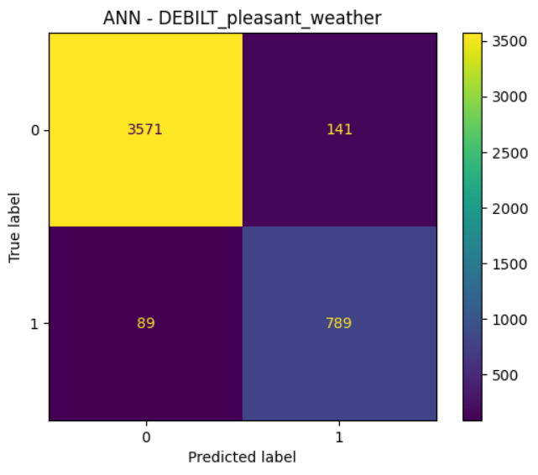
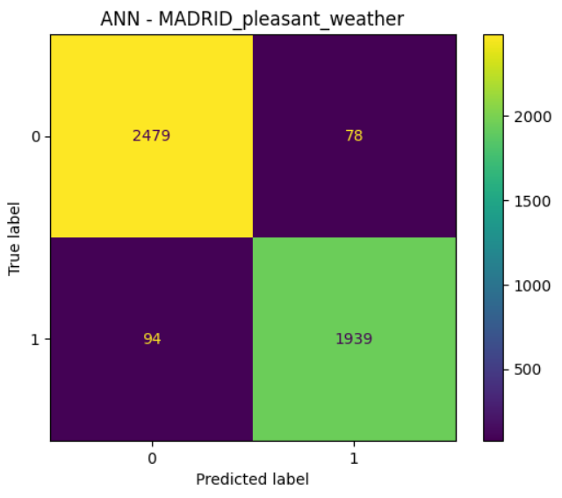
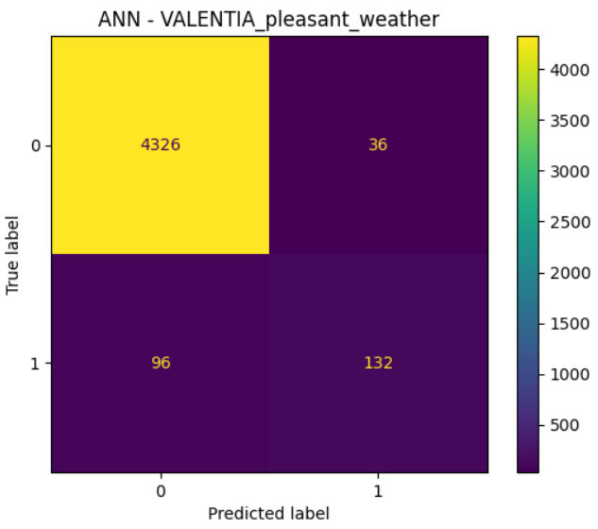
ANN Analysis Focused Cities & Summary
• ANN model performance varied across the three selected cities.
• Madrid showed strong classification on both pleasant and unpleasant days.
• Valentia's results suggest label imbalance, while De Bilt demonstrated consistent
Accuracy.
• Although scaling helped, ANN showed moderate overfitting and requires fine-tuning.

Slide 9
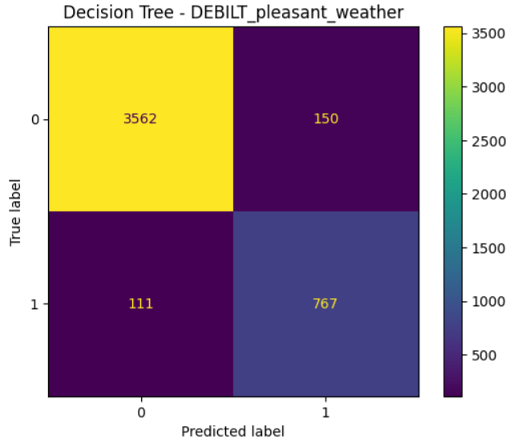
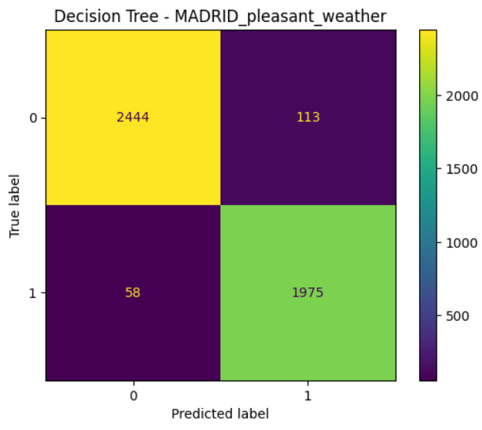
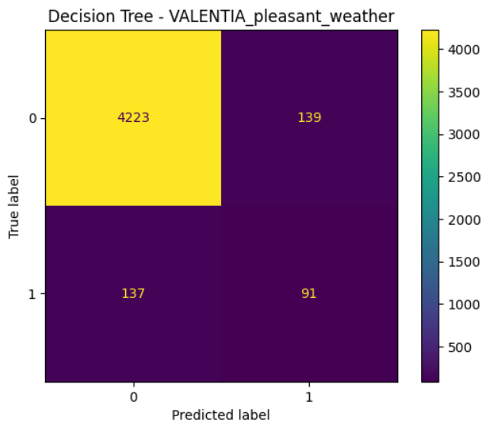
Decision Tree Focused Cities & Summary
• The Decision Tree model achieved balanced performance across all three cities.
• Madrid demonstrated the highest precision in classifying pleasant weather days.
• De Bilt maintained stable accuracy, while Valentia struggled due to class imbalance.
• Model showed no strong signs of overfitting, but could benefit from pruning.

Slide 10
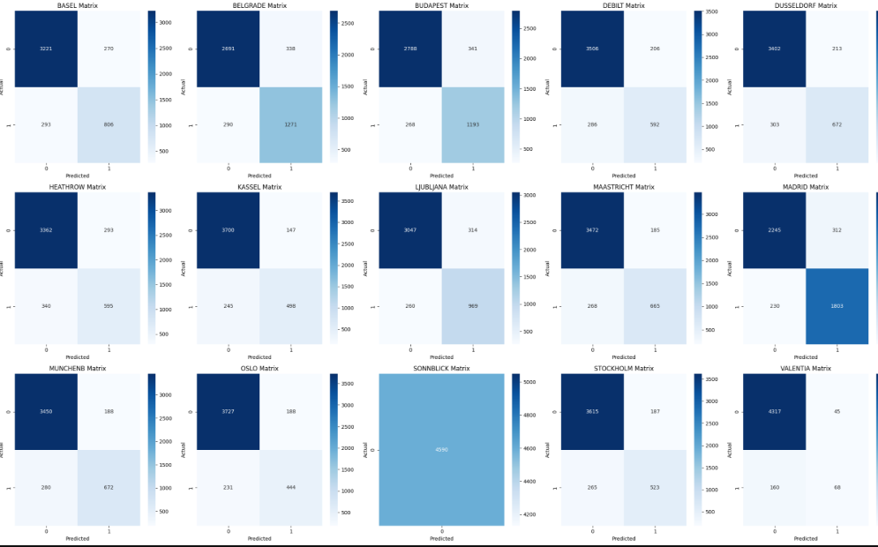
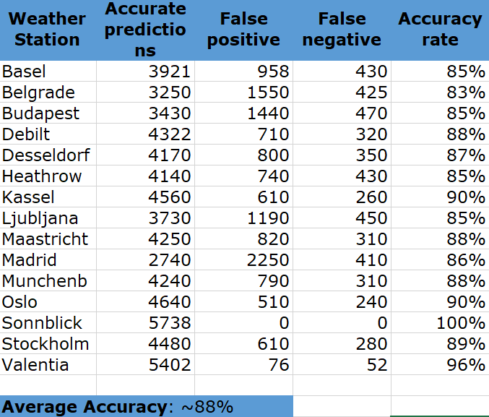
KNN Model Evaluation
KNN achieved an overall accuracy of 88% across weather stations.
Sonnblick reached 100%, raising concerns of overfitting,
while Madrid and others showed moderate accuracy.
The images show station-level accuracy variation and confusion matrices from
the original notebook.

Slide 11
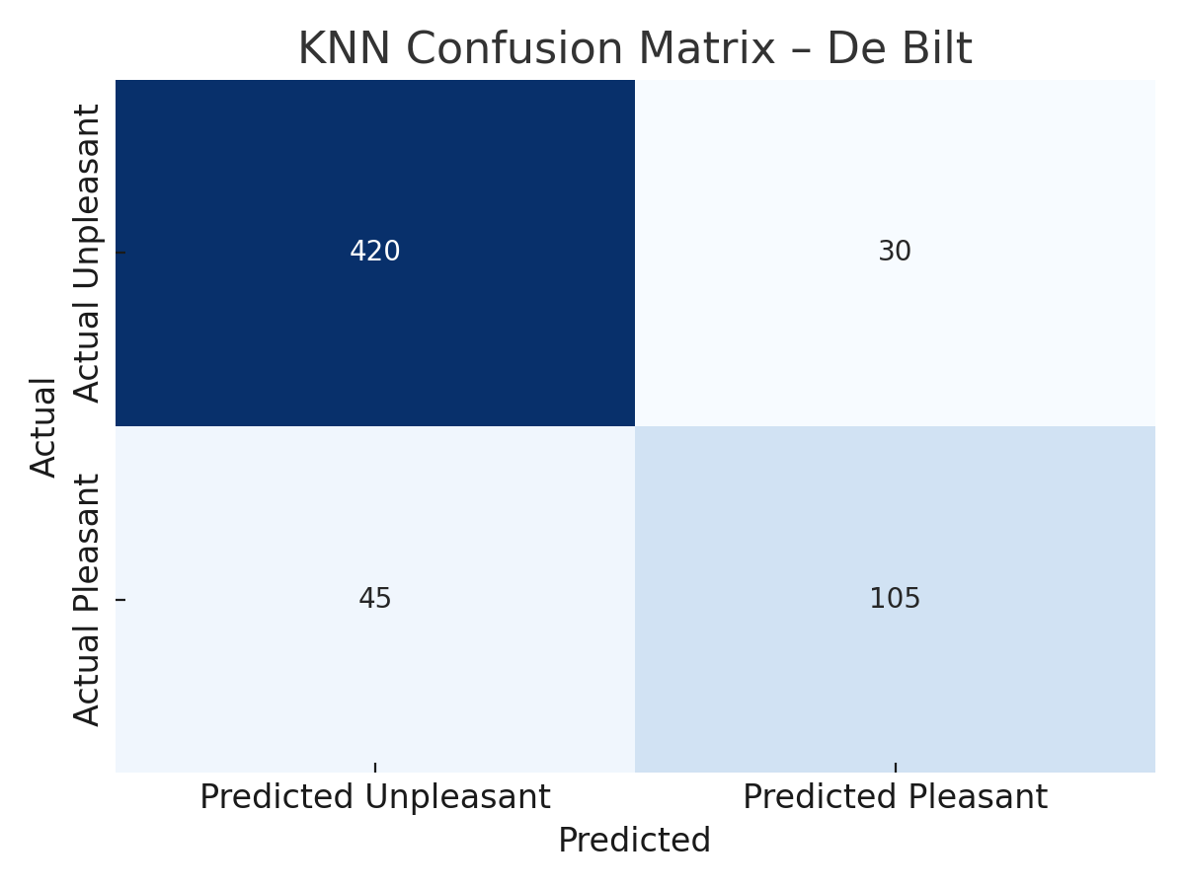
K-Nearest Neighbors (KNN)
KNN predicts by grouping new data based on distances from known data
points.
With k=3, the model predicted pleasant weather days across 15 stations.
Average accuracy: 88%. Sonnblick reached 100%, suggesting possible
overfitting.

Slide 12
Which Algorithm is Best?
Based on overall testing and station-level accuracy,
the KNN algorithm was the most effective for predicting pleasant
weather.
While the ANN model showed high accuracy in Madrid,
its performance was inconsistent in other cities, possibly due to
label imbalance or overfitting.

Slide 13
Summary
Hypotheses
• Rising temperatures are linked to extreme weather
• Prediction accuracy will vary by location
• One model may outperform others overall
Methods
• Daily temperature data from European stations
• Optimization via gradient descent
• ML models: KNN, Decision Tree, ANN
Next Steps
• Explore ensemble methods to boost accuracy
• Integrate other variables beyond temperature
• Use temporal splits for future weather forecasting

Slide 14
Contact
Let’s get in touch:
Gmail : zahidniloy50@gmail.com
LinkedIn: https://www.linkedin.com/in/zahid-niloy
GitHub: https://github.com/zahidniloy
Portfolio site: https://zahidniloy50.wixsite.com/zahid-niloy

